Slide 1
Project 1.2
Olivia Justynski, Yuyang Liu, Jiawei Wang

Slide 2
Compare the variants in Carl’s genome with those found in the GTEx database. Use the results to predict gene expression in various tissues and better estimate the impact of noncoding variants in Carl’s genome.

Slide 3
Writing
Describe eQTLs and the GTEx database. How was the data present in GTEx generated and what scientific questions does it help answer?

Slide 4
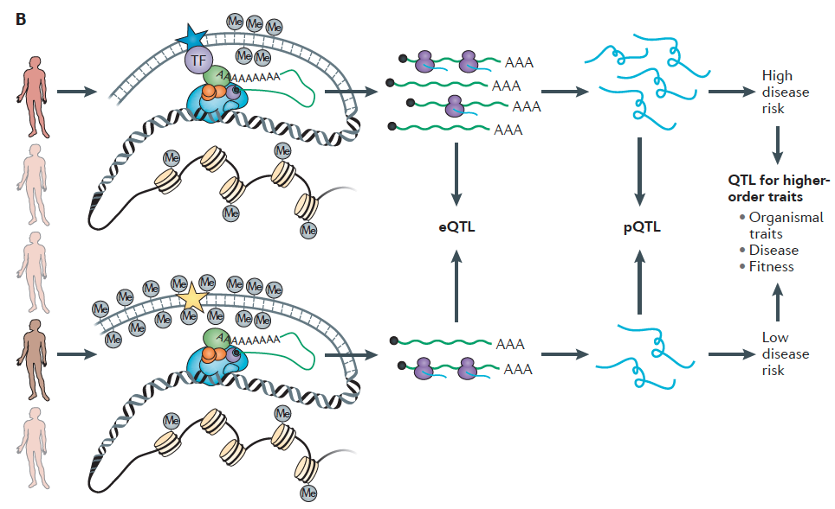

Slide 5
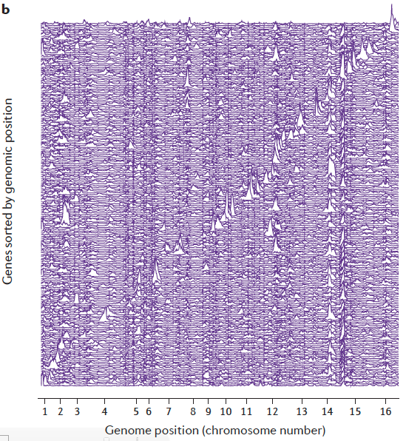

Slide 6
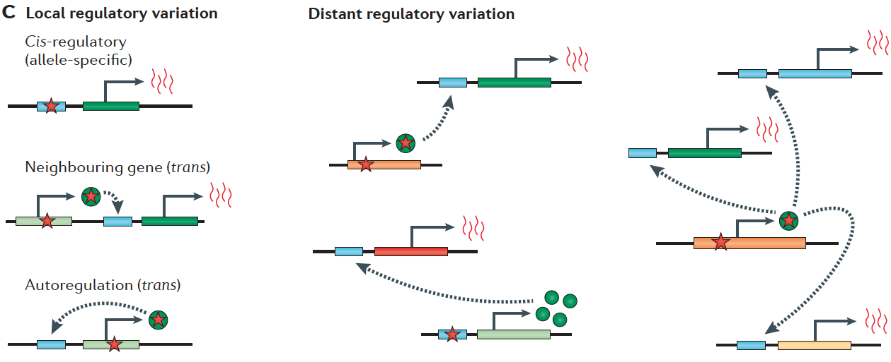

Slide 7
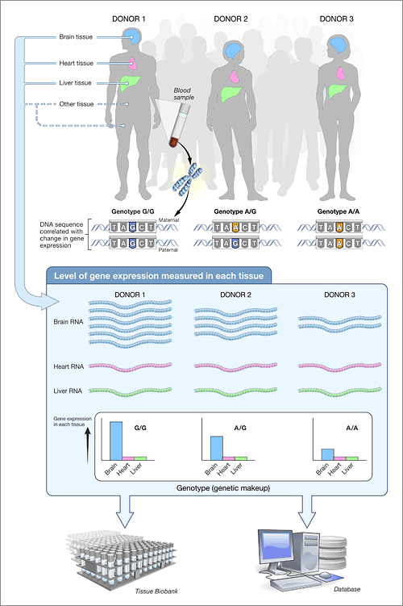

Slide 8
Coding
Propose a tool to identify eQTLs in a subset of Carl’s variants using the GTEx database. What expression changes would you predict in Carl? Make sure to cover tissues that can be easily assayed.

Slide 9
Pipeline
Process the variants in Carl’s genome to identify any eQTLs. Look at multiple tissues (make sure to include tissues that might be able to be tested in a noninvasive manner e.g. blood).

Slide 10
eQTLs identified in different tissues

Slide 11
eQTL Chromosome Distribution

Slide 12
eQTL Chromosome Distribution

Slide 13
eQTL Chromosome Distribution

Slide 14
eQTL Chromosome Distribution

Slide 15
eQTL Chromosome Distribution

Slide 16
eQTL Chromosome Distribution

Slide 17
A hotspot of eQTL on Chromosome 6

Slide 18
Distribution of cumulative effector size

Slide 19
Sample GO analysis--pancreas

Slide 20
Regulome DB analysis
First 3x10⁶ nucleotide on chromosome 1 as input dataset
Score higher than 1f are classified as eQTL

Slide 21
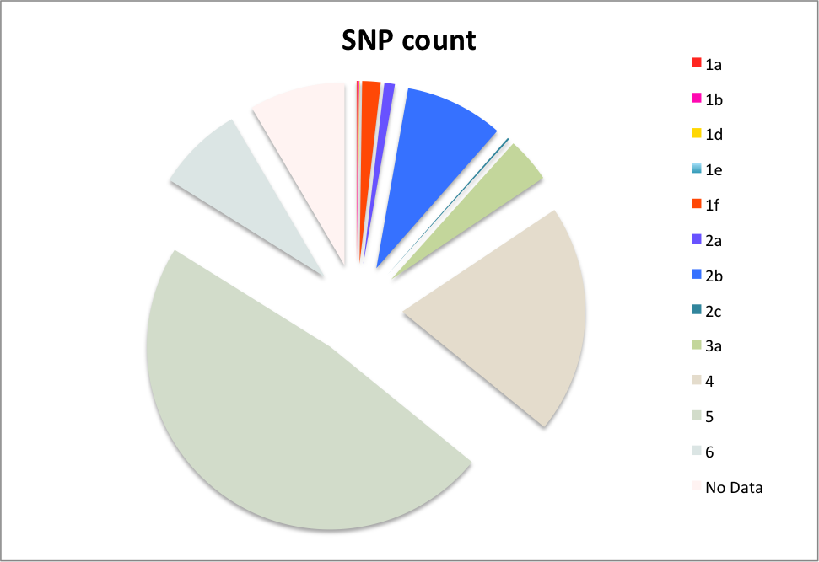
RegulomeDB scores

Slide 23
Example eQTL: rs1886730
Score 1b
Affects expression of TNFRSF14 in lymphoblastoid
http://www.regulomedb.org/snp/chr1/2488607

Slide 24
http://www.regulomedb.org/snp/chr1/2488607

Slide 25

Located within the binding site of FOXO6
Evidence from multiple ChIP-Seq experiments
Near active RSS
http://www.regulomedb.org/snp/chr1/2488607

Slide 26
Correlation between eQTLs predicted by two methods

